Slide 1
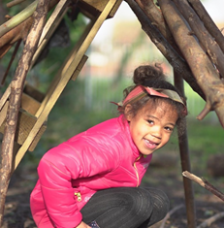
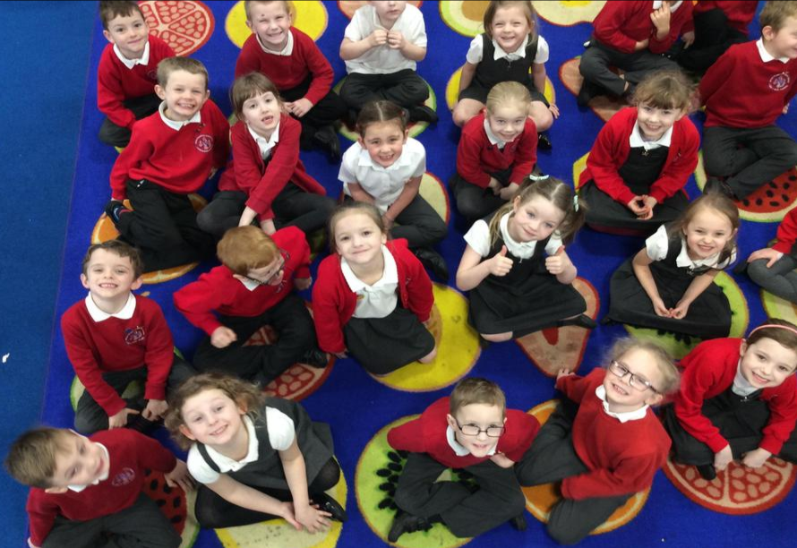
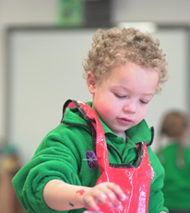
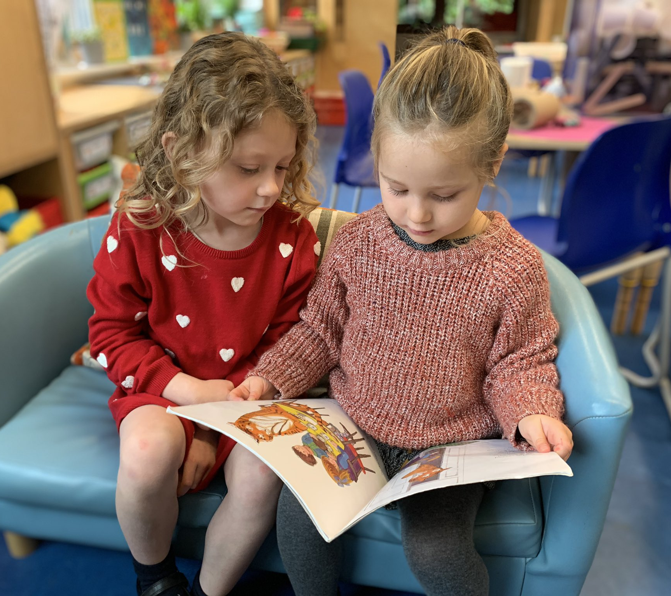
Bath and Wells Multi Academy Trust
Bathford Church School
School Development Plan Priorities 2023-2024
Grow, Care, Serve Share
School Values
BE YOUR BEST| BE KIND|BE RESPECTFUL | BE A TEAM|
OUR STRATEGIC GOALS
Goal 2: Quality First Teaching
Goal 3: Excellent mental health
.
Goal 1: Cognitive and Metacognitive Strategies
Goal 4: Leadership
Teachers manage cognitive load in order to enable children to transfer new learning to long-term memory. Teachers activate prior knowledge, teach small steps and provide opportunities for children to plan, monitor and evaluate their own learning.
Teachers identify and remove barriers, improving outcomes for children. Teachers give clear explanations, model, check frequently for understanding, offer guided practice before independent practice, scaffold and make effective use of flexible grouping, adapting teaching to meet needs of the children.
Throughout the school community there is a culture of shared responsibility
for mental health and wellbeing. Our staff are recognised as our most precious resource and their wellbeing, as well as that of the children, is secure. This empowers all to be the best versions of themselves.
Our Global Curriculum leadership approach supports middle leadership development effectively allowing leaders to monitor, support and develop subjects in the long term. Leaders can evidence the impact of their leadership.
OUR VISION
BWMAT CORE RESPONSIBILITIES
To equip our children with the knowledge, skills and values they need both to make sense of the world and to become caring, responsible global citizens.
MORAL & ETHICAL VALUES
Our distinctively Christian ethos underpins all the work of the Trust and every aspect of curriculum delivery.
We reinforce values of kindness, respect, forgiveness, perseverance and love.
Alongside an outstanding education, we deliver a focus on the quality of our children’s characters.
We guarantee year-round support for the most vulnerable and less well-off, as well as those who suffer discrimination and those living with disability.
EDUCATIONAL & ASPIRATIONAL VALUES
Every child will experience the highest quality teaching and learning. This teaching and learning will be delivered in the best possible environment.
Teaching staff are committed to the best and most innovative practice and research.
All children from all backgrounds are given the chance to change their lives positively through learning.
Every school is on a trajectory to become or remain outstanding.
Outstanding leaders in all our schools.

